Slide 1
Content
Irrigation system and reason
What is Arduino UNO?
What is MH sensor and LCD?
Diagram
conclusion

Slide 2
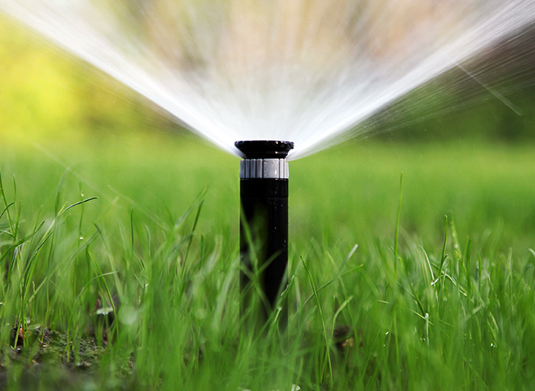
Irrigation system and reason
What is irrigation system?
Why we use this system?

Slide 3
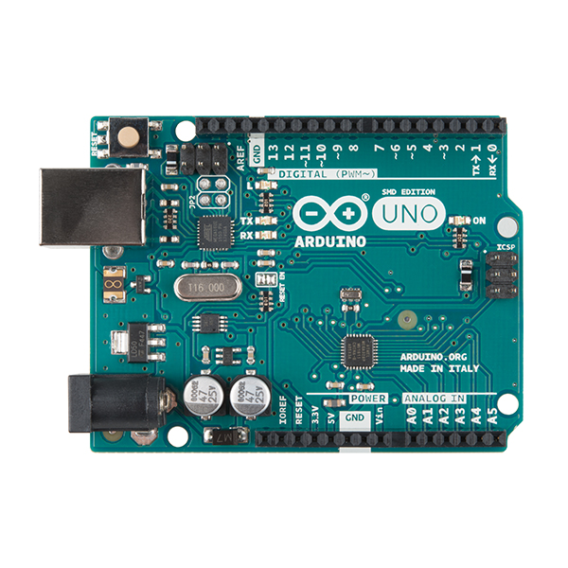
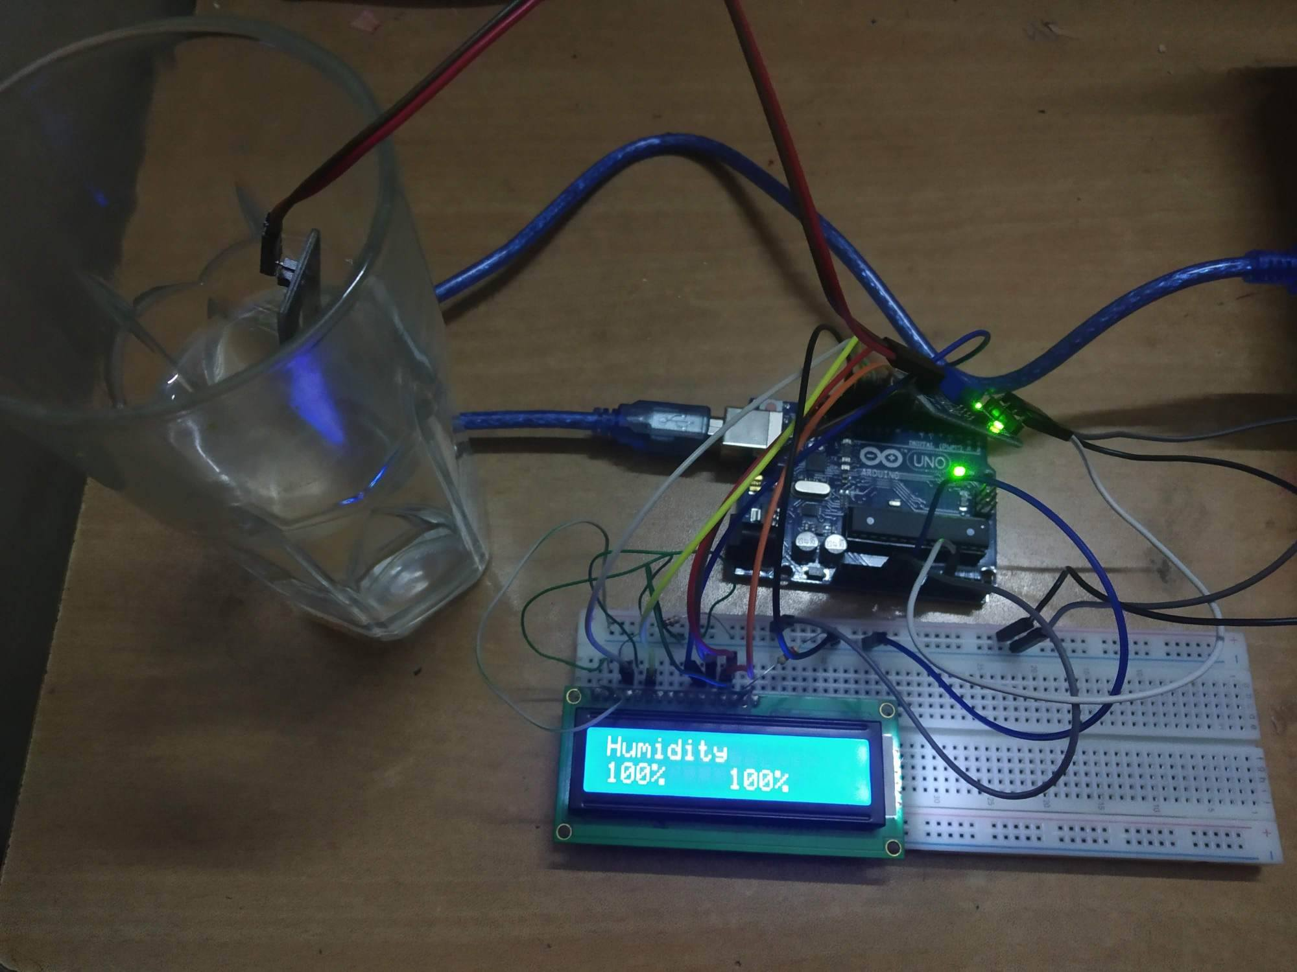
Equipment
What is Arduino UNO?
What is MH sensor and LCD?

Slide 4
Diagram

Slide 5

Conclusion

